Slide 1
SWP2SWB – Social Work in an Unequal World
Conventional approaches to addressing global poverty through development

Slide 2
Lecture overview –Conventional approaches to addressing global poverty through development
The global institutional landscape
The concept of ‘development’ and its historical application
    Modernisation approaches
  Contemporary development approaches
    UN Millennium Development Goals and Sustainable Development Goals
    Human development and multidimensional poverty
    Transforming global institutions

Slide 3
“Global poverty is highly contested and politicized. It is an ill-structured and complex social problem able to be defined in different ways, the problem space changing with time and location, and the causal arguments being slippery and difficult to establish” (St Clair, 2006 cited in Hulme, 2015 p. 58)
“The concept of global poverty, and its increasing association with sustainable development, has not evolved in a vacuum or in some form of global academic seminar room. It is a product that is intimately related to structures of power and overt and covert processes of political contestation” (Hulme, 2015, p. 56)

Slide 4
Introduction
The various factors involved in issues of global poverty are particularly complex, and relate to situations and circumstances that have developed over centuries
Issues of global poverty (and arguably to a lesser extent, global inequality) are of concern to an ever-expanding “web of multilateral, national, sub- national and local institutions spread across the public sector, private business and civil society” (Hulme 2012, p. 81).
To a significant extent, the manner in which the more powerful and influential of these institutions views issues of poverty and the preferred responses to it, more or less represents an identifiable ‘conventional approach’
That is, they are particularly influential in determining the dominant view of poverty (what is causing it, who is responsible, how it should be addressed) and the extent to which this changes or develops over time
This reflects the ability of such institutions to shape thinking and responses, but also the recognition that such thinking and responses do not remain completely static over time
As such, it is important to examine what the current conventional or dominant view of poverty looks like, how it has emerged, and to what extent it is shifting
In this topic, we focus predominantly on the role of the largest and most influential global institutions (or what are also referred to as global governance institutions)

Slide 5
The global institutional landscape
Hulme (2015) outlines the central role played by powerful global institutions in determining the manner in which issues of global poverty are viewed and responded to:
“The values that underpin international efforts to tackle global poverty, and the policies and actions that are pursued, are constrained – some would say are undermined – by the day- to- day realities of power politics in international relations” (Hulme, 2015 p. 82).
Hulme groups these global institutions under 3 main categories:
    The United Nations and associated bodies – including the United Nations Development Program (UNDP)
    The ‘Bretton Woods’ institutions (BWI’s) – particularly the World Bank, International Monetary Fund (IMF), and World Trade Organisation (WTO – formerly GATT)
    Other ‘associations of states’ – such us Organisation for Economic Cooperation & Development (OECD), European Union (EU), African Union (AU), G8/G20 etc

Slide 6
Two paradigms
According to Hulme (2015), there have tended to be significant ideological differences driving the agendas of the UN and the BWI’s – hence they have tended to view poverty in contrasting ways, and have different preferences for addressing poverty
Therefore despite some convergence in more recent times, generally speaking there have been clear distinctions between the ‘UN paradigm’ and the ‘Bretton Woods paradigm’
UN paradigm (aligns with a multidimensional view of global poverty/inequality) | Bretton Woods paradigm (aligns with an “individual” view of global poverty/inequality)
UN and associated agencies Views poverty as primarily caused by lack of international cooperation Views globalisation as exacerbating inequalities Believes markets must be managed in order to prioritise social and environmental objectives | World Bank, IMF, WTO Views poverty as primarily caused at national/regional level Favours expansion of globalisation Favours complete market liberalization

Slide 7
The concept of ‘development’
As with many of the key issues/concepts in this subject, the concept of ‘development’ is contested and subject to multiple and often competing definitions or understandings (ie, ideology, values, positions etc) (see Pawar & Cox, 2010 Ch 2)
Generally speaking, the concept of development relates to ideas about economic, social, political and cultural progress and the process by which this occurs or is influenced to occur
In some sense, development can be regarded as ‘natural’ – something that occurs over time as humanity progresses and seeks to improve its environment (eg survival, growth, advancement etc)
However, our interest here is with the nature, direction and processes by which particular types or aspects of development are pursued, by whom, and to what ends or purpose – that is, with development that is to a large extent purposely created and which has both intended and unintended consequences
More specifically, our interest is with the relationship between international/global development and efforts to address poverty (and to a lesser extent, inequality)

Slide 8
Development as ‘modernisation’
Essentially, ‘modernisation’ approaches to development were based on the belief that poorer countries (many of which were former colonies of richer countries) would continue to experience significant and extreme poverty so long as they remained rooted in traditional practices and outside of the processes of globalisation and modernisation. Thus they were regarded as suffering from ‘underdevelopment’ (see Desai & Solas, 2012)
The idea was that in order to progress (end hence to address poverty), poorer countries would have to adopt the economic, political, social and cultural practices that were dominating and enabling progress in richer ‘Western’, ‘developed’ nations:
underdeveloped/traditional developing/transitional developed/modern
Further, western governments, corporations and international institutions (such as the BWI’s) would play a key role in assisting, enabling and encouraging such development opportunities – thereby requiring developing countries to become more ‘open’ to such assistance in order to reap the benefits of development
However, critics argue that such development efforts were rarely so benign or altruistic in their intentions, and that in practice, the processes of modernisation and development – so aggressively pursued by the BWI’s as part of the ‘Washington Consensus’ in the post WW2 period – largely functioned to the general detriment of poorer ‘developing’ countries (see Serr, 2012/2017; Midgely, 2014)

Slide 9
Contemporary approaches to development
The limited effectiveness and negative impacts of ‘modernisation’ approaches became more recognised in the latter part of the 20th century, prompting a shift in approach by global institutions (though the true extent of this shift is subject to intense debate –see Midgley 2014 for further detail)
This shift was reflected in the UN World Summit for Social Development in 1995 which adopted the ‘Copenhagen Declaration (1995)’ and represented a desire to see a greater focus on ‘people centred development’ and a renewed commitment to addressing poverty
The shift away from ‘modernisation’ approaches is reflected in contemporary approaches to development which are based on a more multidimensional understanding of development and the centrality of poverty to this. Such a multidimensional approach is characterised in the UN/UNDP’s strategies:
    Millennium development goals (MDG’s) – 2000-2015 http://www.un.org/millenniumgoals/
    Sustainable development goals (SDG’s) – 2016-2030 http://www.un.org/sustainabledevelopment/
Hulme (2015, Ch 4 ) suggests that the MDG’s can be seen as a form of ‘compromise’ between the ‘UN’ and ‘BWIs’ paradigms, and a similar argument could also be made about the more recent SDG’s
The multidimensional understanding of poverty reflected in the SDG agenda means a wider scope of social policies are identified as being required within countries

Slide 10
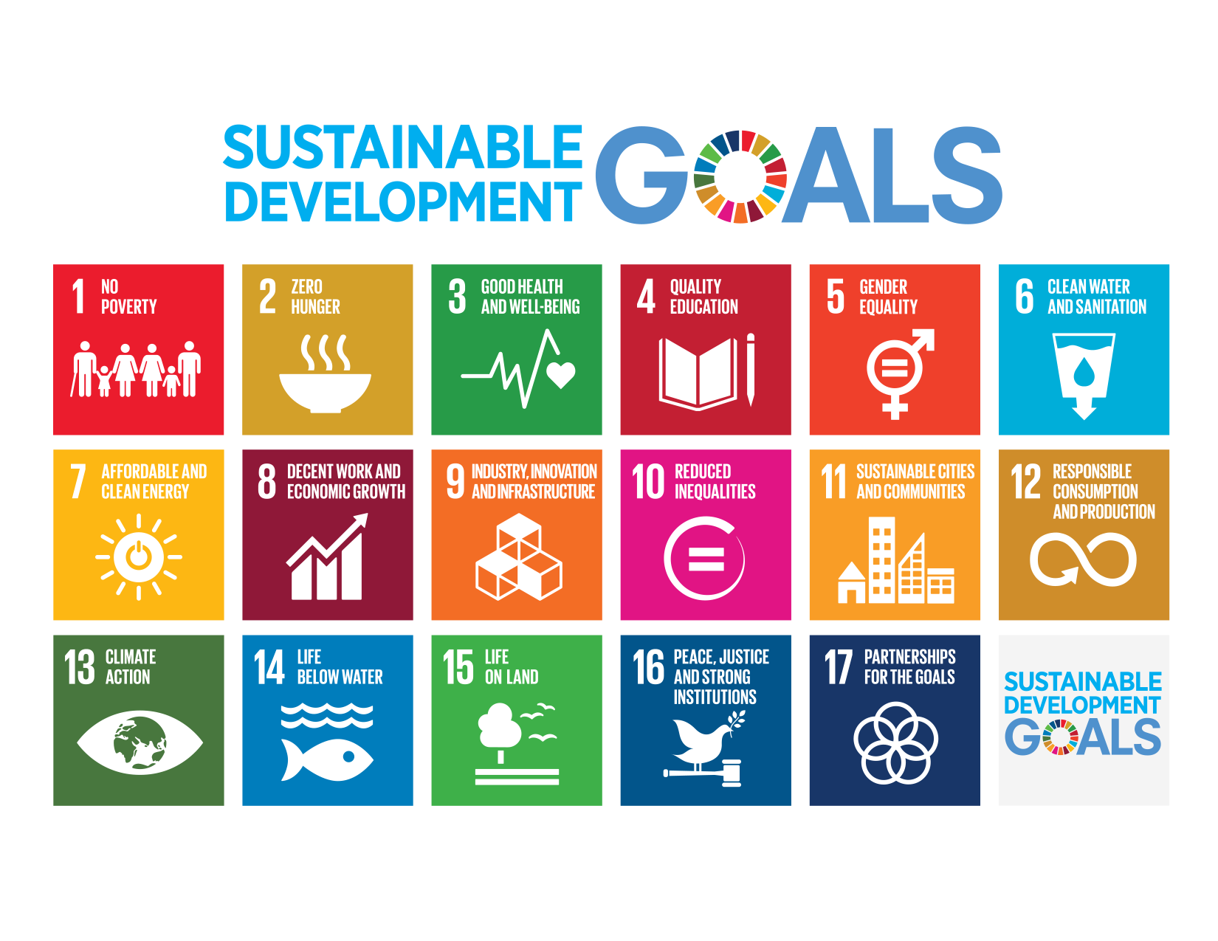

Slide 11
Goal 1 – End poverty in all its forms everywhere
Targets
By 2030, eradicate extreme poverty for all people everywhere, currently measured as people living on less than $1.90 US a day
By 2030, reduce at least by half the proportion of men, women and children of all ages living in poverty in all its dimensions according to national definitions.
Implement nationally appropriate social protection systems and measures for all, including floors, and by 2030 achieve substantial coverage of the poor and the vulnerable.
By 2030, ensure that all men and women, in particular the poor and the vulnerable, have equal rights to economic resources, as well as access to basic services, ownership and control over land and other forms of 13 property, inheritance, natural resources, appropriate new technology and financial services, including microfinance.
By 2030, build the resilience of the poor and those in vulnerable situations and reduce their exposure and vulnerability to climate-related extreme events and other economic, social and environmental shocks and disasters.
Ensure significant mobilization of resources from a variety of sources, including through enhanced development cooperation, in order to provide adequate and predictable means for developing countries, in particular least developed countries, to implement programmes and policies to end poverty in all its dimensions.
Create sound policy frameworks at the national, regional and international levels, based on pro-poor and gender-sensitive development strategies, to support accelerated investment in poverty eradication actions
Goal 1: End poverty in all its forms everywhere – United Nations Sustainable Development

Slide 12
How were the SDG’s proposed to be achieved? (see http://www.un.org/sustainabledevelopment/development-agenda/ )
The Addis Ababa Action Agenda that came out of the Third International Conference on Financing for Development provided concrete policies and actions to support the implementation of the new agenda.
Implementation and success will rely on countries’ own sustainable development policies, plans and programmes, and will be led by countries. The Sustainable Development Goals (SDGs) will be a compass for aligning countries’ plans with their global commitments.
Nationally owned and country-led sustainable development strategies will require resource mobilization and financing strategies.
All stakeholders: governments, civil society, the private sector, and others, are expected to contribute to the realisation of the new agenda.
A revitalized global partnership at the global level is needed to support national efforts. This is recognized in the 2030 Agenda.
Multi-stakeholder partnerships have been recognized as an important component of strategies that seek to mobilize all stakeholders around the new agenda

Slide 13
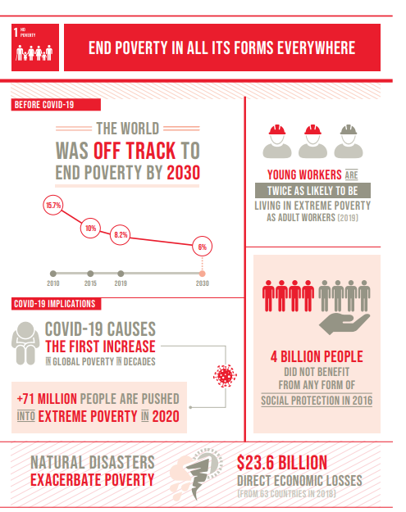
Progress on the SDGs
The Sustainable Development Goals Report 2020 reviews progress of the 2030 Agenda for Sustainable Development amid the COVID-19 crisis.
The report uses the latest available data and estimates to track progress towards the SDGs before the pandemic started, but it also looks at some of the initial impacts of COVID-19 on specific Goals and targets.
As indicated in in the table here, it is evident that progress towards ending poverty was hampered before the impact of COVID and the world was not on track to end poverty by 2023
A concerning issue highlighted here is the include the 4 billion people who do not benefit from any form of social protection
Key issues reported to be underpinning this trend are reported to include substandard working conditions, inadequate social protections systems, and climate change.
The UN has argued that effective social protection schemes and policies, along with government spending on key services, could help those left behind get back on their feet and find a way out of poverty.
A global indicator framework was also adopted in 2017 to monitor progress against the goals
See: https://unstats.un.org/sdgs/report/2020/progress-chart-2020.pdfmonitor progress against the SDGs
Source: Source: UN, Sustainable Development Goals Report, 2020

Slide 14
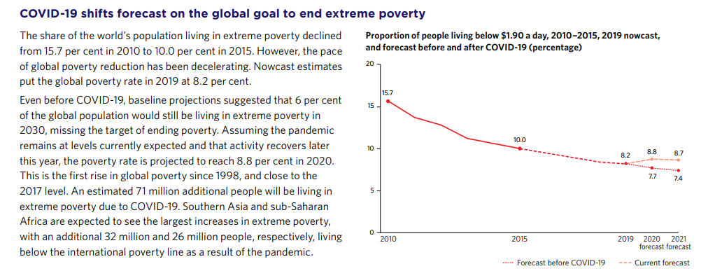
Impact of COVID 19 on goal to end extreme poverty
As noted in the previous slide, UN has predicted that ‘tens of millions of people will be pushed back into poverty, undoing years of steady improvement … the importance of robust social protection systems for safeguarding the poor and vulnerable is becoming clearer than ever’. (UN, 2020, p. 24)
Source: UN, Sustainable Development Goals Report, 2020, p. 26.

Slide 15
Human development and multidimensional poverty
Sustainable Development Goal (SDG) 1 aims to end poverty in all its forms everywhere. Although previously defined only in monetary terms, poverty is now understood to include the lived reality of people’s experiences and the multiple deprivations they face
In week 8 we introduced the concept of human development and multidimensional poverty in a global context – that is, that poverty is about more than income and involves a range of deprivations and impacts.
Although previously defined only in monetary terms, poverty is now understood to include the lived reality of people’s experiences and the multiple deprivations they face.
It is measured by a multidimensional poverty index (MPI). In the global MPI, people are counted as multidimensionally poor if they are deprived in one-third or more of 10 indicators
Based on the work of Amartya Sen which focussed on understanding poverty and development from the perspective of capabilities
(see http://www.ophi.org.uk/multidimensional-poverty-index/ )
Source: http://www.ophi.org.uk/multidimensional-poverty-index/

Slide 16
Multidimensional poverty Index 2020
The most recent report on the MPI has shown that:
Across 107 developing countries and 5.9 billion people, 1.3 billion people—22 percent—live in multidimensional poverty.
Of the 1.3 billion multidimensionally poor people, 82.3 percent are deprived in at least five indicators simultaneously
Children show higher rates of multidimensional poverty: half of multidimensionally poor people (644 million) are children under the age of 18. One in three children is poor compared with one in six adults.
About 84 percent of multidimensionally poor people live in Sub-Saharan Africa (558 million) and South Asia (530 million). Two-thirds of multidimensionally poor people live in middle-income countries.
71 percent of the 5.9 billion people covered experience at least one deprivation; however, the average number of deprivations they experience is five.
107 million multidimensionally poor people are age 60 or older—a particularly importantly figure during the COVID-19 pandemic.
Before the pandemic 47 countries were on track to halve multidimensional poverty between 2015 and 2030. But 18 countries, including some of the poorest, were off track.
OPHI & UNDP (2020) Charting pathways out of multidimensional poverty: Achieving the SDGs, United Nations Development Programme and Oxford Poverty and Human Development Initiative. https://ophi.org.uk/global-mpi-2020/
“The overarching aim of the Sustainable Development Goals (SDGs) is to leave no one behind. People who are identified as multidimensionally poor are being “left behind” in several SDGs at the same time. (OPHI & UNDP, 2020, p. 20)

Slide 17
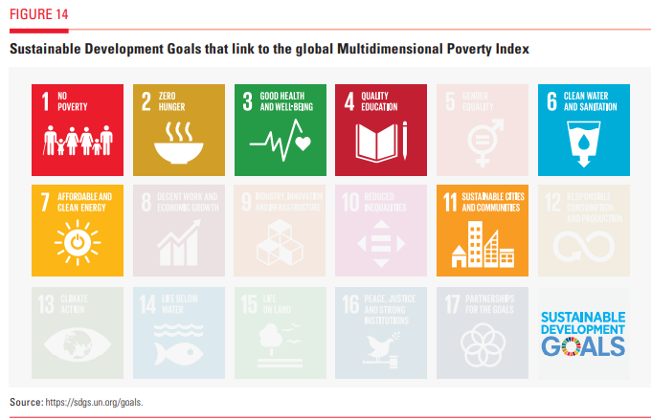
The SDGs and Multidimensional poverty
In addition to the SDG goal 1 of ending poverty in all its forms everywhere, other SDG goals remain directly relevant to tackling multidimensional poverty at a global level because there are many interlinkages among deprivations and ‘individuals experience poverty as overlapping sources of disadvantage’. (see OPHI & UNDP, 2020)
For example, SDG goal 4 pertains to ensuring access to education, which is a key dimension of multidimensional poverty.
Sub-Saharan African countries have the highest percentages of people who are multidimensionally poor and deprived in years of schooling (OPHI & UNDP 2020, p. 25)
However, the world is not on track to meet education targets (UN, 2020, pp. 32-33)

Slide 18
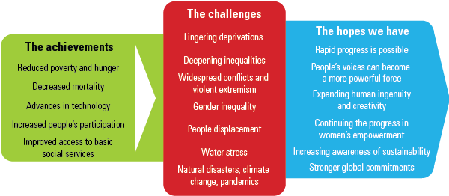
‘Shocks’ and threats to human development
The UN recognises that progress on development is threatened by a range of ‘shocks’, many of which are structural in nature and require sustained global cooperation to address. These shocks include:
Economic risks – poverty, unemployment, insecure employment, lack of savings etc
Inequality – income, wealth, gender, education, health etc
Health risks – hunger, malnutrition, disease, access to affordable healthcare
Environment and natural disasters – climate change, environmental degradation, poor sanitation, pollution etc
Food insecurity – volatility in prices and availability of food
Physical insecurity – war, conflict, violence, human rights violations etc
(see Human Development Report, 2016 pg 122-128)
Source: http://report.hdr.undp.org/

Slide 19
Transforming global institutions
In order to achieve targets of increasing human development, there has been growing recognition of the need to also transform the way that global institutions operate, recognising that some of the problematic aspects of globalisation and global governance which have continued to act against the realisation of development goals
In 2016 HDR identifies the main ‘global institutions’ as comprising: Markets, Multilateral organisations (UN, World Bank, IMF etc), Global civil society (corporations, NGO’s, partnerships etc)
“Global institutional reforms should encompass the broader areas of regulation of global markets, the governance of multilateral institutions and the strengthening of global civil society” (UN development report 2016 : overview p. 17)
More recently the 2019 UN Human Development Report acknowledged the influence of globalisation on the capacity of national governments to tackle poverty and inequality, though it doesn’t provide the same emphasis on the need to regulate global markets. The actions of national governments are given greater emphasis, and international action is seen as something that should “complement” their endeavours:
    Globalization means national policy is often circumscribed by entities, rules and events beyond the control of national governments, with pervasive downward pressures on corporate income tax rates and labour standards. Tax evasion and avoidance are made easier by insufficient information, by the rise of large digital companies operating across tax jurisdictions and by inadequate interjurisdictional cooperation. In these policy domains international collective action must complement national action (UNDP 2019, p. 17)
The changing emphasis given to the problem of human development/poverty alleviation by the UNDP over time (global institutions/globalisation or national governments) reflects the ongoing tensions and debates between market/individual and multidimensional explanations of poverty and inequality.

Slide 20
Summary
Global institutions are key players in ‘conventional’ or ‘mainstream’ efforts (both past and present) to address issues of global poverty.
The UN and BWI’s have been most prominent and have tended to have contrasting approaches – however these appear to have somewhat converged in recent decades (though the extent of this convergence and its significance is subject to ongoing debate)
Efforts to address global poverty have often been part of broader international development efforts – though ideas of development are contested and dominant approaches have changed over time
Historically, development efforts were shaped by ‘modernisation’ theories and the policies of the ‘Washington Consensus’ – critics suggest these were largely to the detriment of poorer nations
Contemporary efforts are based upon a broader understanding of development and a multidimensional view of poverty – this is reflected in the UN’s Millennium/Sustainable Development Goals and in their Human Development and multidimensional poverty Index

Slide 21
references
Desai, M. & Solas, J. (2012). Poverty, development and social justice. In K. Lyons., T. Hokenstad., M. Pawar., N Huegler., & N, Hall (Eds.), The Sage handbook of international social work (pp. 85-99). London: SAGE.
Hulme, D. (2015) Global poverty: how global governance is failing the poor. Hoboken: Taylor & Francis.
Midgley, J. (2014). Social development: theory and practice. London: SAGE.
Pawar, M., & Cox, D. (2010) Social development. In P. Manohar., & D. Cox (Eds.), Social development: critical themes and perspectives (pp. 13-36). New York: Routledge.
Serr, K. (2013). Against the odds: Poverty in Addis Ababa. North Melbourne: Australian Scholarly Publishing.
United Nations (2016). Human Development Report 2016. http://hdr.undp.org/en/2016-report
United Nations (2019). Human Development Report 2019. http://hdr.undp.org/sites/default/files/hdr2019.pdf
United Nations (2020). Sustainable Development Goals Report 2020.
OPHI & UNDP (2020) Charting pathways out of multidimensional poverty: Achieving the SDGs, United Nations Development Programme and Oxford Poverty and Human Development Initiative. https://ophi.org.uk/global-mpi-2020/
World Bank Group (2016). Taking on inequality: Poverty and shared prosperity 2016.Washington D.C.: World Bank.

